Slide 1


DataBase Logic in Business Applications
Al.I. Cuza University of Iași
Faculty of Economics and Business Administration
Department of Accounting, Information Systems
and Statistics
Triggers – part III
Keeping track of important operations.
Protecting `computed`/denormalized attributes from de-synchronization
By Marin Fotache & Co.

Slide 2
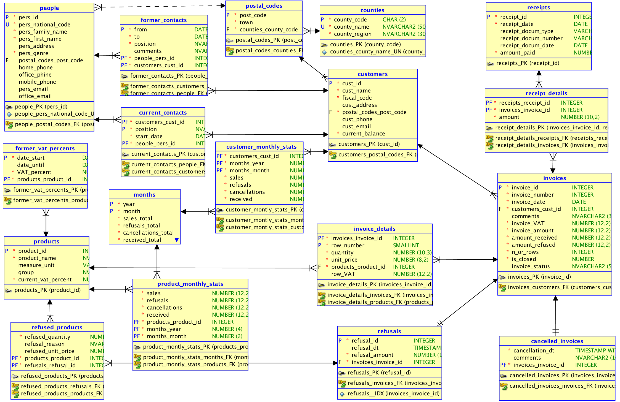
Synchonizing `products` and `former_vat_percents` tables

Slide 3
Protecting (Keeping in sync) the Computed/Denormalized Attributes

Slide 4
Scripts on GitHub
See section 06_Triggers/ of the course:
https://github.com/marinfotache/Database-Logic-in-Business-Applications/tree/master/06_Triggers
Prerequisites (for setting up the database to this point)
06-00-2_fixed_DDL_script_sales_2015.sql
06-00-3_add_constraints_sales_2015.sql
06-01a_en_sequences.sql
06-01b_en_data_cleaning__surrogate_keys.sql
06-01c_en_cascade_updates.sql
06-02a_en_triggers_invoices.sql
06-02b_en_triggers__invoice_details.sql
06-02c_en_triggers__receipts__receipts_details.sql
06-02d_en_proc_auto_ins__receipts.sql
Scripts related to this presentation:
06-03a_en_logs_and_triggers.sql
06-03b_en_general_log.sql
06-03c_en_protecting_denormalized_attributes.sql

